Slide 1
Mamba-Inspired Models for Radio Localization
CHENXI Zhang

Slide 2
Contents
Background & Data Processing
Methodology & Experimental Design
Results, Discussion & Conclusions

Slide 3
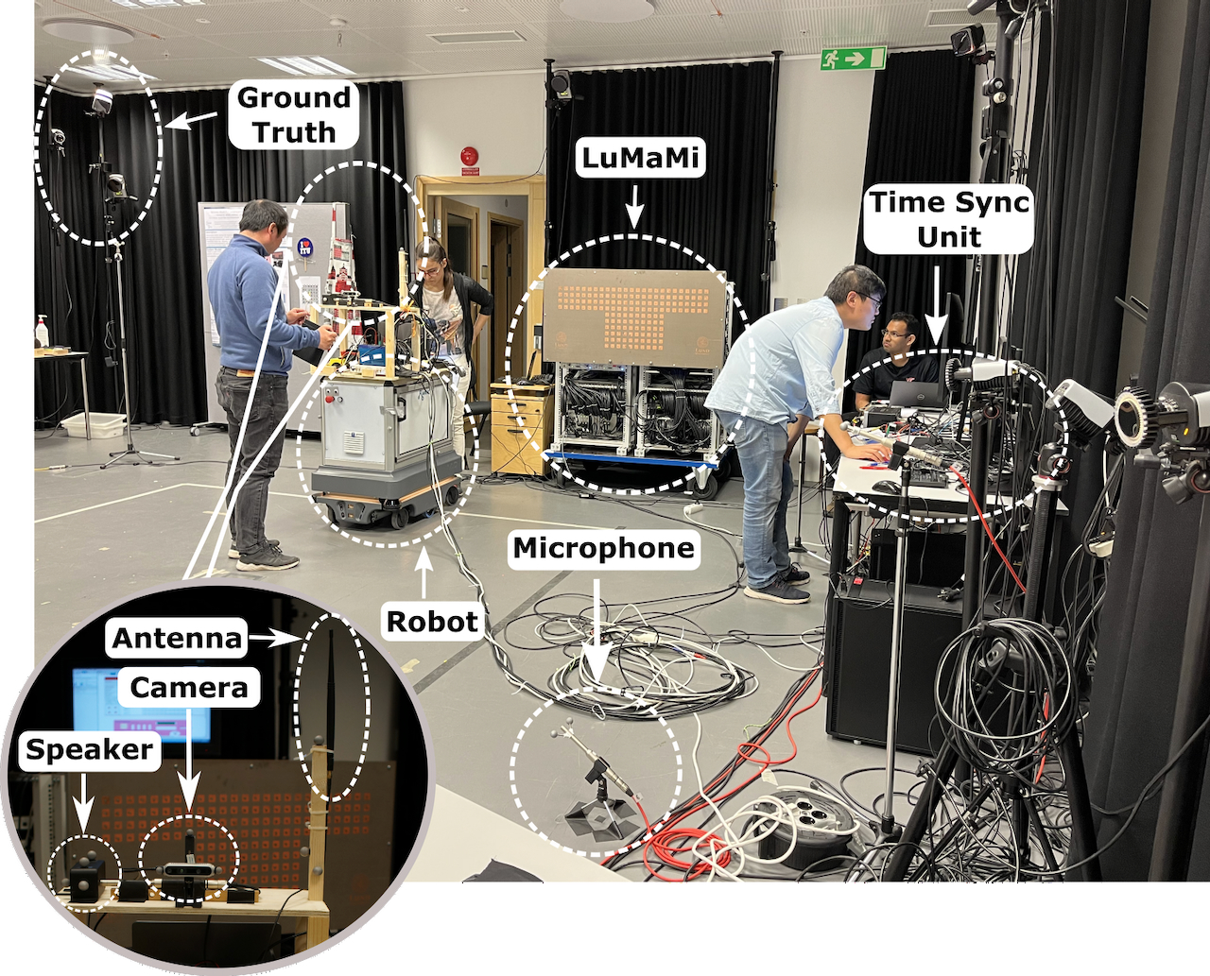
Background & Task: Wireless Localization
LuViRA Dataset Overview
70 spatial grids covering the operational environment
100 fps temporal resolution for high‑fidelity signal capture
4,700+ annotated frames with ground‑truth (x, y) positions
100 antennas, each containing 100 subcarriers, with a center frequency of 3.7 GHz and a bandwidth of 20 MHz.
Objective
Estimate precise (x, y) coordinates from temporal wireless signal sequences, enabling accurate indoor localization for positioning applications.
G. Tian, I. Yaman, M. Sandra, X. Cai, L. Liu and F. Tufvesson, "Deep-Learning-Based High-Precision Localization With Massive MIMO," in IEEE Transactions on Machine Learning in Communications and Networking, vol. 2, pp. 19-33, 2024, doi: 10.1109/TMLCN.2023.3334712.

Slide 4
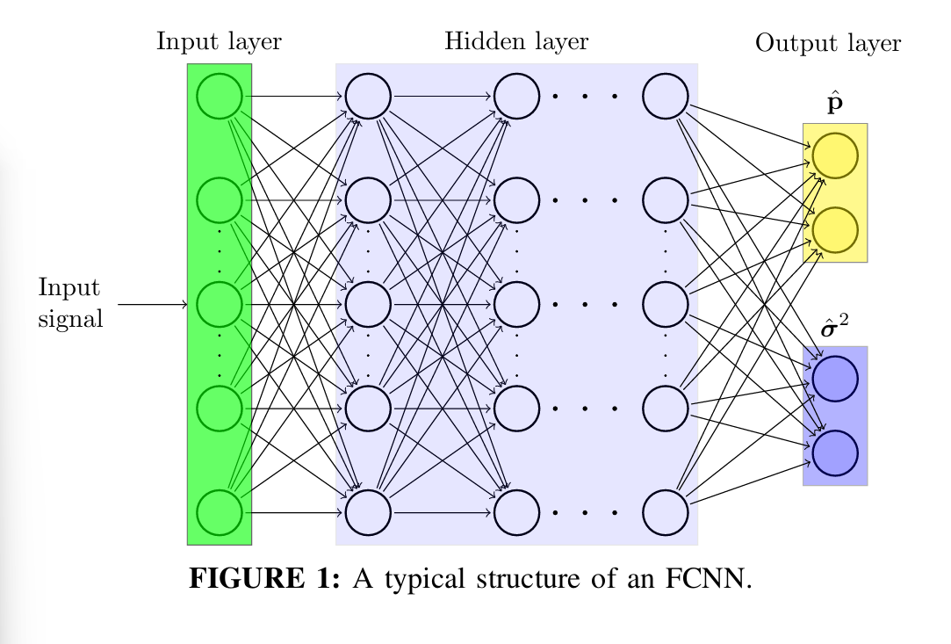
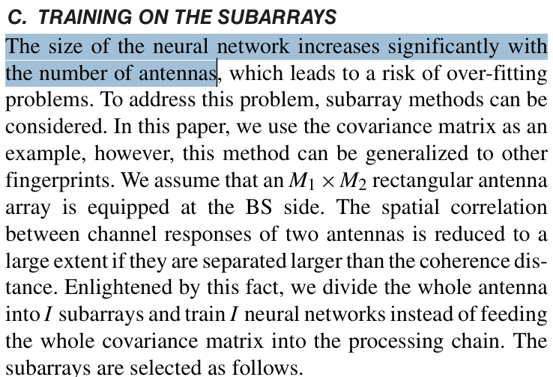
Background – Previous works
FCNN: Fully Connected Neural Network
localization as a static nonlinear regression problem via multilayer perceptrons, without explicit temporal memory
G. Tian, I. Yaman, M. Sandra, X. Cai, L. Liu and F. Tufvesson, "Deep-Learning-Based High-Precision Localization With Massive MIMO," in IEEE Transactions on Machine Learning in Communications and Networking, vol. 2, pp. 19-33, 2024, doi: 10.1109/TMLCN.2023.3334712.
Notes:
Foundation models (FMs), which are large models pre-trained on massive datasets and then fine-tuned for specific downstream tasks, have become an effective paradigm in modern machine learning. Nearly all such models are based on the Transformer architecture and its core attention module.

Slide 5
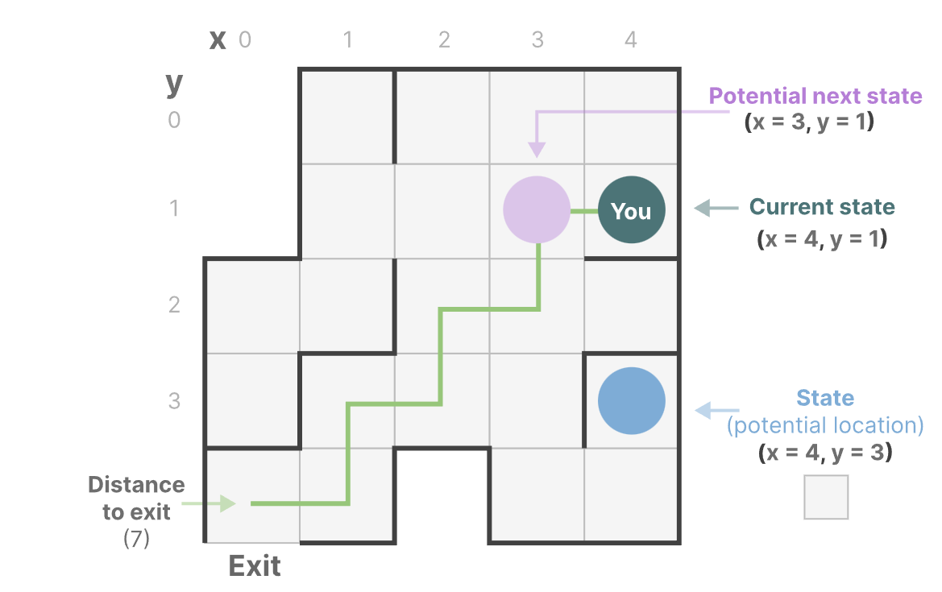
Background - Why use Mamba
State Space Model
A State Space contains the minimum number of variables that fully describe a system. It is a way to mathematically represent a problem by defining a system’s possible states.
Grootendorst, M. (2024). A Visual Guide to Mamba and State Space Models.
Notes:
A state space model uses states to describe a system ,such as in this picture ,all the potential positions are states

Slide 6
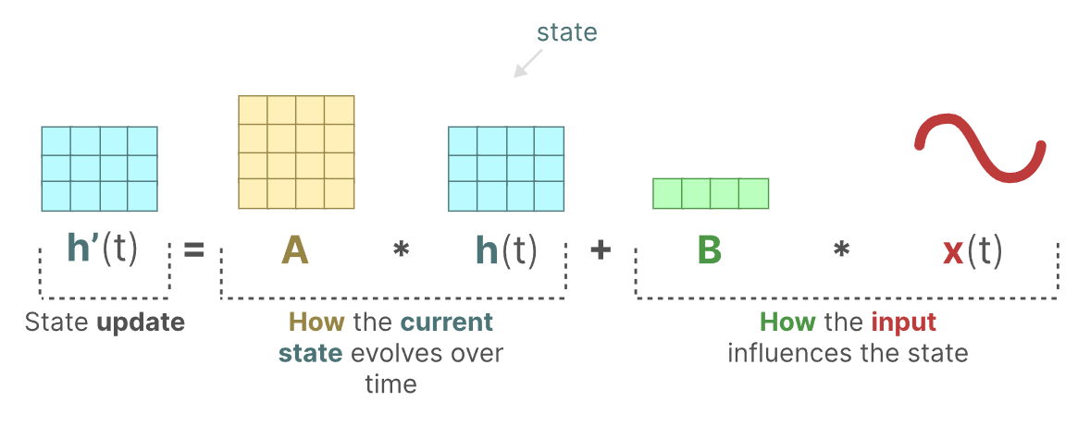
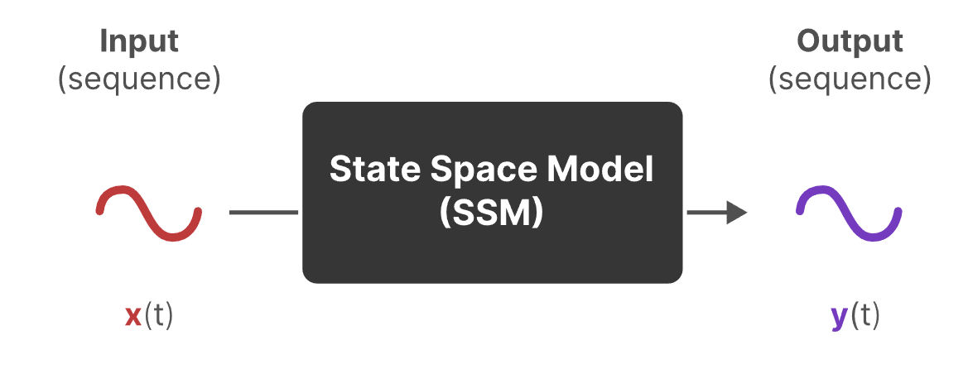
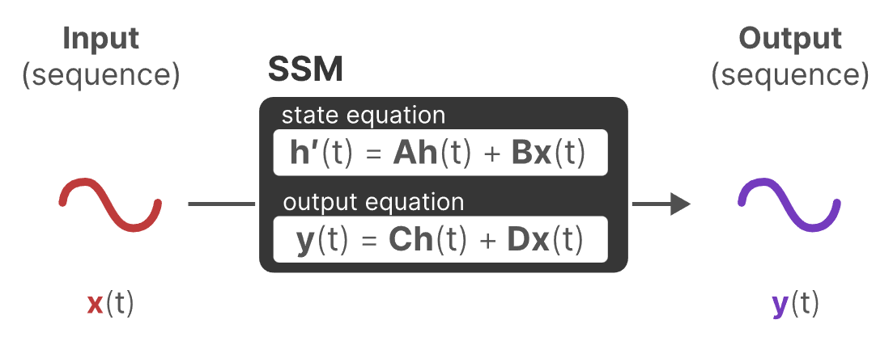
Background - Why use Mamba
State Space Model
SSMs are models used to describe these state representations and make predictions of what their next state could be depending on some input, which is well suited for positioning tasks.
Traditionally, at time t, SSMs:
map an input sequence x(t) — (e.g., moved left and down in the maze)
to a latent state representation h(t) — (e.g., distance to exit and x/y coordinates)
and derive a predicted output sequence y(t) — (e.g., move left again to reach the exit sooner)
SSMs assume that dynamic systems, such as an object moving in 3D space, can be predicted from its state at time t through two equations.
D = 0 for positioning tasks
Grootendorst, M. (2024). A Visual Guide to Mamba and State Space Models.
Notes:
And here u can see the first equation illustrates how the state changes, the second shows how the state connected with output
And based on this formula u can easily notice that it’s very similar to rnn

Slide 7
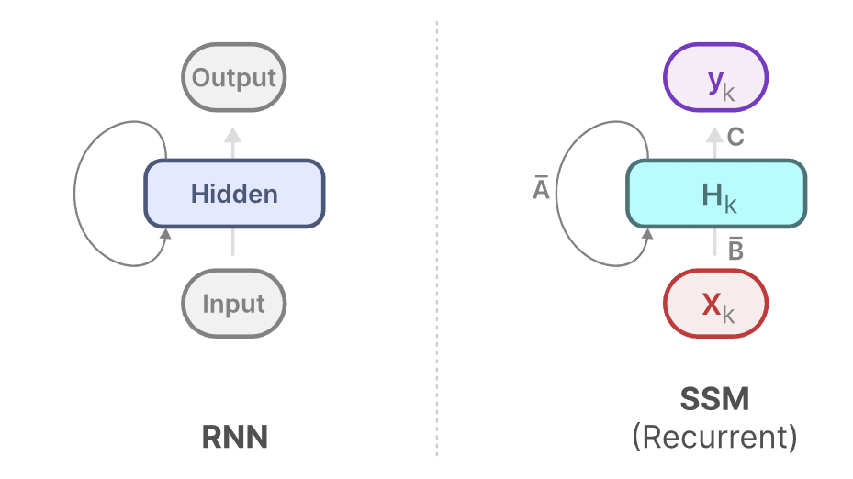
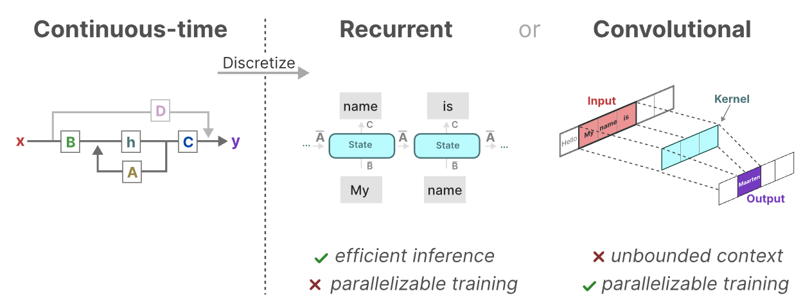
Background - Why use Mamba
State Space Model
SSM enables parallel training and recursive inference.
Grootendorst, M. (2024). A Visual Guide to Mamba and State Space Models.
Notes:
The structure of them are basically the same, so we can treat them in the same way

Slide 8
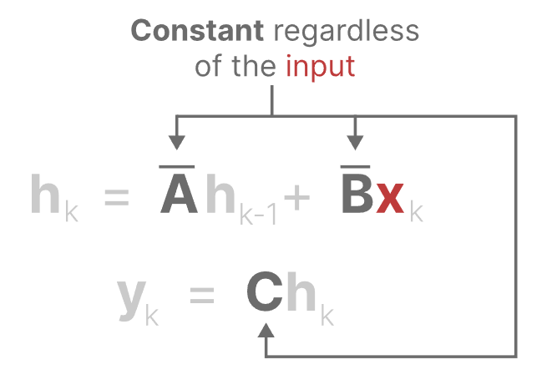
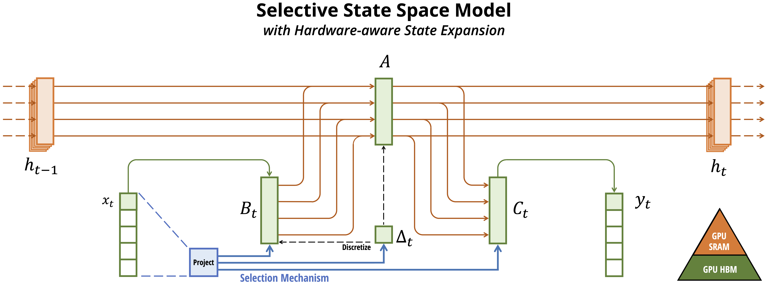
Background - Why use Mamba
Mamba is a State Space Model more hardware-efficient
Using hidden states to store historical information and process sequences with recursive updates.
SSM
Grootendorst, M. (2024). A Visual Guide to Mamba and State Space Models.
Notes:
Structured state space models refer to a mathematical framework for sequence modeling that integrates control theory with deep learning. They handle long-term dependencies through state variables and linear matrix transformations. Models like S4 and Mamba utilize structured matrices (e.g., diagonal matrices, polynomial projections) to optimize computations, maintaining linear complexity while preserving sequential memory capabilities. This addresses the quadratic complexity issue of Transformers and is suitable for long-sequence tasks in NLP, computer vision, and other domains. Specific meaning: Based on state transition equations (A, B, C matrices), it achieves efficient sequence modeling through structured parameterization (e.g., low-rank decomposition, polynomial approximation). Compared to traditional RNNs, it constrains state transitions within learnable structured matrices, enabling parallel computation and hardware optimization (e.g., FFT acceleration), thereby resolving the high computational cost of Transformers in long sequences. Extensions: Mamba employs selective state updates (S4 + selective gating), while Spatial-Mamba incorporates spatial fusion mechanisms for visual tasks. By combining semi-decomposable matrices with attention duality, it achieves efficient multimodal modeling, driving breakthroughs in large models for image classification, object detection, and related domains.

Slide 9
Background – Previous works
FCNN: Fully Connected Neural Network
Model | Typical Usage for Sequences | Parameter Scaling w.r.t. sequence length T | Compute Scaling w.r.t. T (Forward) | Key Implication for LUVIRA-like data (T≈4000)
FCNN (Flatten whole sequence) | Concatenate all frames → one huge vector | O(T · d · h) (grows linearly with T) | O(T · d · h) | Becomes parameter-heavy / memory-hungry; first layer explodes (often hundreds of millions params). Not scalable.
FCNN (Per-frame + pooling) | FCNN on each frame independently + mean/max pooling | O(d·h + (L−1)·h²) (independent of T) | O(T · (d·h + (L−1)·h²)) | Scales in compute, but does not model long-range temporal dependencies (treats frames independently). Performance ceiling.
SSM (Mamba-like) | Encode each frame → sequence model over time | O(L·d²) (independent of T) | O(L · T · d²) (linear in T) | Designed for long sequences: long-range dependency modeling with linear-time compute, stable parameter count. Best fit.
T: sequence length (e.g., 4000 frames at 100 Hz)
d: per-frame embedding dimension
h: FCNN hidden width
L: number of layers
Notes:
Foundation models (FMs), which are large models pre-trained on massive datasets and then fine-tuned for specific downstream tasks, have become an effective paradigm in modern machine learning. Nearly all such models are based on the Transformer architecture and its core attention module.

Slide 10
Background – Previous works
FCNN: Fully Connected Neural Network
Model | Assumed Architecture | Parameter Formula | Plug-in Values | Total Params
FCNN (Flatten whole sequence) | Input (T * d) → 1 hidden layer h → output o | (T d)*h + h + h * o + o | (T=4000, d=256, h=512, o=4) | 524,290,564 (~524.3M)
FCNN (Per-frame + pooling) | Per-frame: (d ->h -> o), applied to each frame; then mean/max pooling over time | (d * h + h + h * o + o) | (d=256, h=512, o=4) | 133,636 (~0.134M)
SSM (Mamba-like) | L layers, model dim d | (L * k * d^2)) | (L=3, d=128, k=4) | 196,608 (~0.197M)
T: sequence length (e.g., 4000 frames at 100 Hz)
d: per-frame embedding dimension
h: FCNN hidden width
L: number of layers
Notes:
Foundation models (FMs), which are large models pre-trained on massive datasets and then fine-tuned for specific downstream tasks, have become an effective paradigm in modern machine learning. Nearly all such models are based on the Transformer architecture and its core attention module.

Slide 11
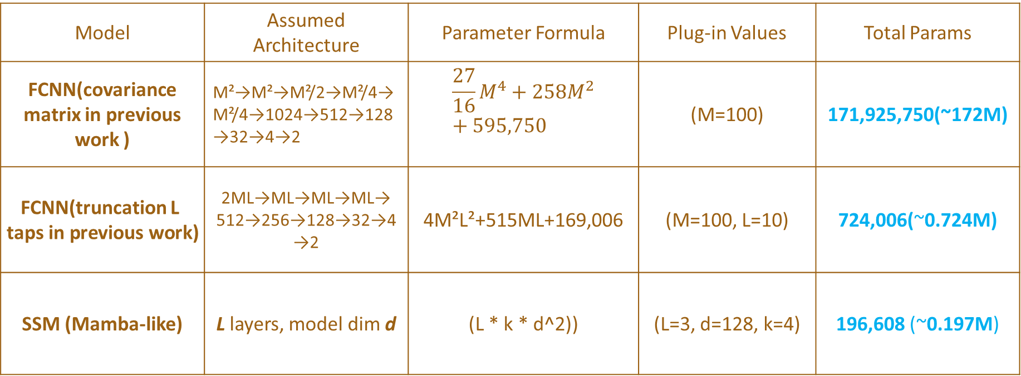
Background – Previous works
FCNN: Fully Connected Neural Network
Model | Assumed Architecture | Parameter Formula | Plug-in Values | Total Params
FCNN(covariance matrix in previous work ) | M²→M²→M²/2→M²/4→M²/4→1024→512→128→32→4→2 | $$\frac{27}{16}M^{4}+258M^{2}+595,750$$ | (M=100) | 171,925,750(~172M)
FCNN(truncation L taps in previous work) | 2ML→ML→ML→ML→ 512→256→128→32→4→2 | 4M²L²+515ML+169,006 | (M=100, L=10) | 724,006(~0.724M)
SSM (Mamba-like) | L layers, model dim d | (L * k * d^2)) | (L=3, d=128, k=4) | 196,608 (~0.197M)
Tian, G., Yaman, I., Sandra, M., Cai, X., Liu, L., & Tufvesson, F. (2023, May). High-precision machine-learning based indoor localization with massive MIMO system. In ICC 2023-IEEE International Conference on Communications (pp. 3690-3695). IEEE.
Notes:
Foundation models (FMs), which are large models pre-trained on massive datasets and then fine-tuned for specific downstream tasks, have become an effective paradigm in modern machine learning. Nearly all such models are based on the Transformer architecture and its core attention module.

Slide 12
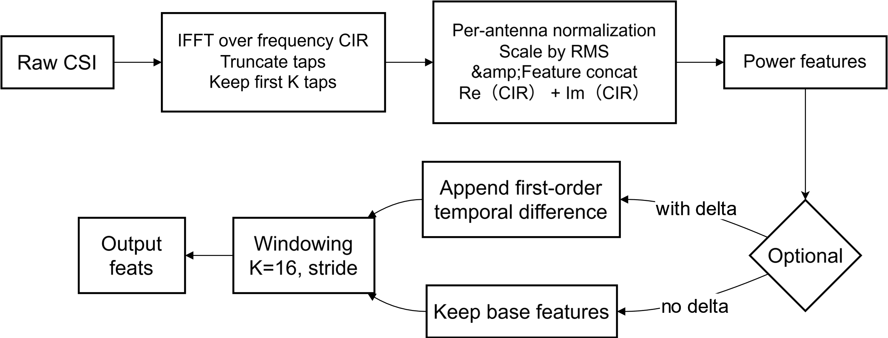

Data Processing Pipeline(CSI → CIR features)
A structured approach transforms raw CSI(channel state information) data from sensor into training-ready CIR(channel impulse response) features through alignment, segmentation, and normalization stages.
Output artefacts: feats.npy, xy.npy, ts.npy, stats_train.npz — ready for model ingestion

Slide 13
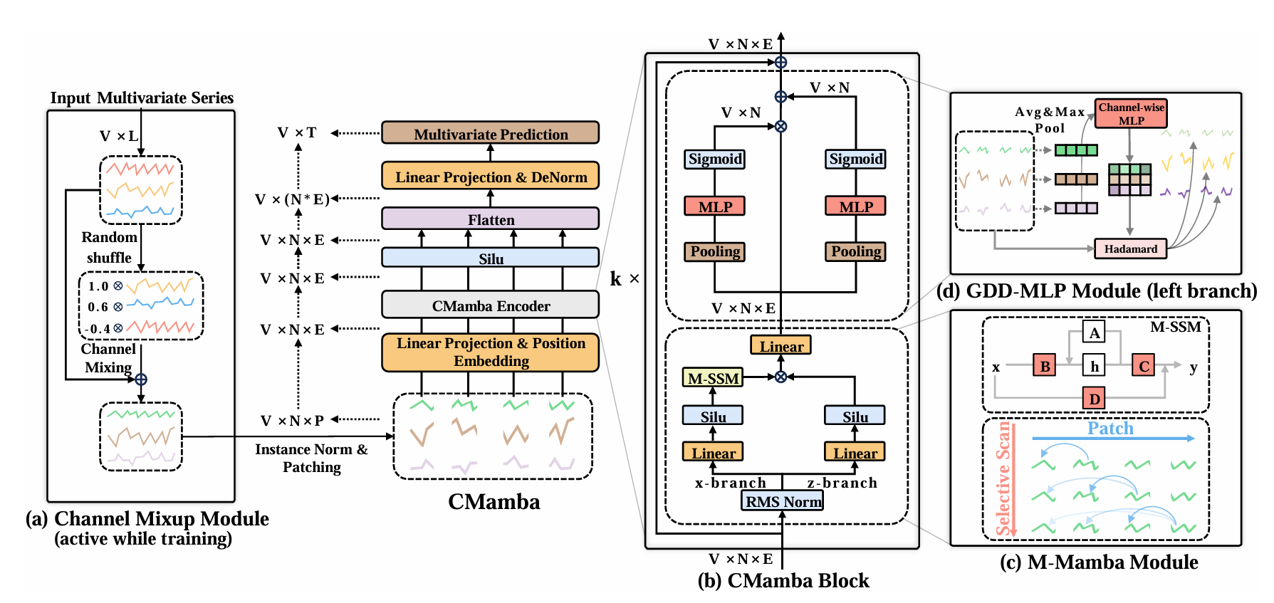
Initial Hypothesis : Channel Mamba Architecture
Design Rationale
Multi‑channel modelling approach to explicitly capture cross‑channel dynamics and interactions in wireless signal processing.
Intended Benefit
Architecture Strategy
Richer feature representation through dedicated channel‑wise processing branches, potentially improving localisation accuracy.
Parallel Mamba blocks operating on individual channels, followed by cross‑channel fusion mechanisms.
H. Shi, K. Jin, X. Ren, W. Li and Y. Zhou, "Channel Mamba: A Mamba-Driven Selective State-Space Model for Channel Prediction of High-Mobility MIMO in 6G IoT," in IEEE Transactions on Wireless Communications, vol. 25, pp. 5291-5305, 2026, doi: 10.1109/TWC.2025.3617502.
.

Slide 14
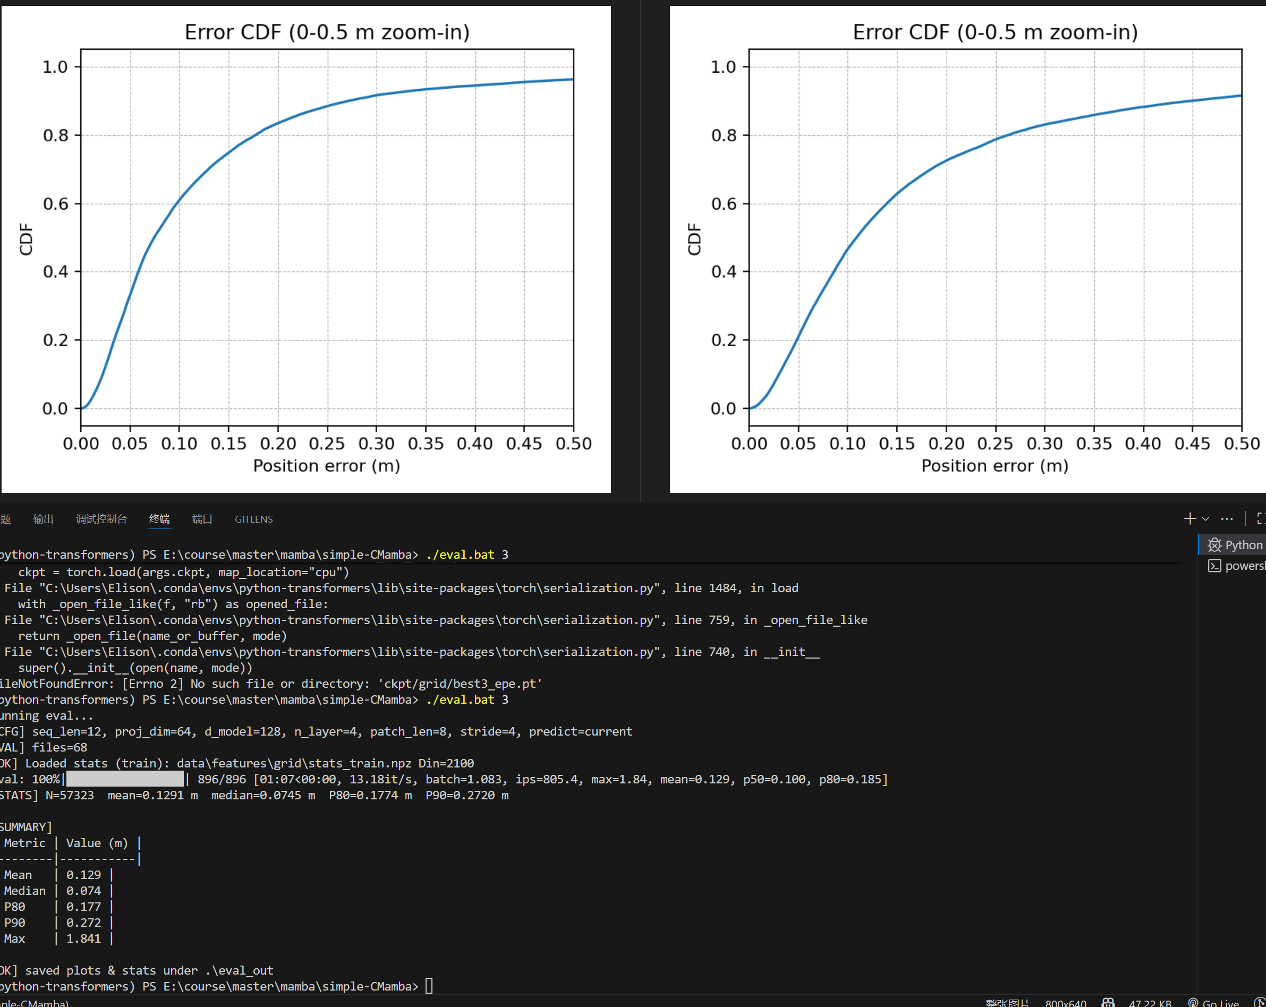
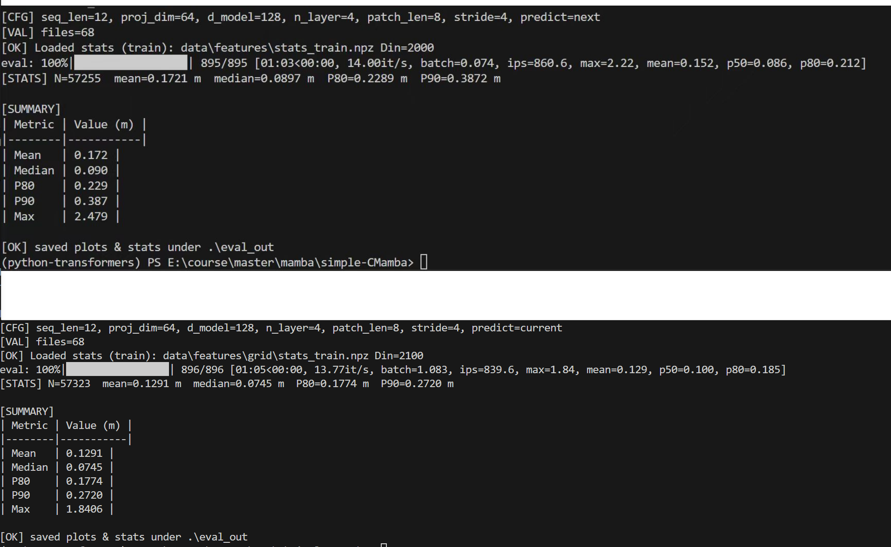
Initial Hypothesis : Channel Mamba Architecture

Slide 15
Initial Hypothesis : Channel Mamba Architecture
Critical Observation: Limited Practical Gains
Empirical Results
Channel Mamba demonstrated marginal accuracy improvements (≈3–4% over simpler alternatives) whilst incurring substantial computational overhead.
Model
Test EPE (cm)
Parameters
Cost Analysis
Channel Mamba
17.2
8.08MB
Increased model parameters (+40–60%)
Slim Mamba
17.8
3.40MB
Higher computational requirements (FLOPs)
Mamba v1
XX
XX
Significantly extended inference latency
Quantisation complexity for deployment
Table: Comparative performance and complexity metrics

Slide 16

Strategic Shift: Adopting Standard Mamba v1
Architectural Simplification
Temporal Modelling Focus
Single unified processing path replaces multi‑channel branching, reducing structural complexity whilst maintaining expressiveness.
Mamba v1's selective state‑space design excels at short‑window temporal sequences typical of wireless localisation tasks.
Hyperparameters
Window length: K=16 samples
Projection dimension: 64
Model dimension: d_model=64
Network depth: 3 layers
Patch configuration: length=8, stride=4
Deployment Advantages
Streamlined architecture enables easier optimisation, quantisation, and hardware mapping for embedded deployment.
Notes:
After run the training on these two models, we are able to identify optimal hyperparameters with a notably short window length, indicating that we don’t need to have complex historical memory structures

Slide 17
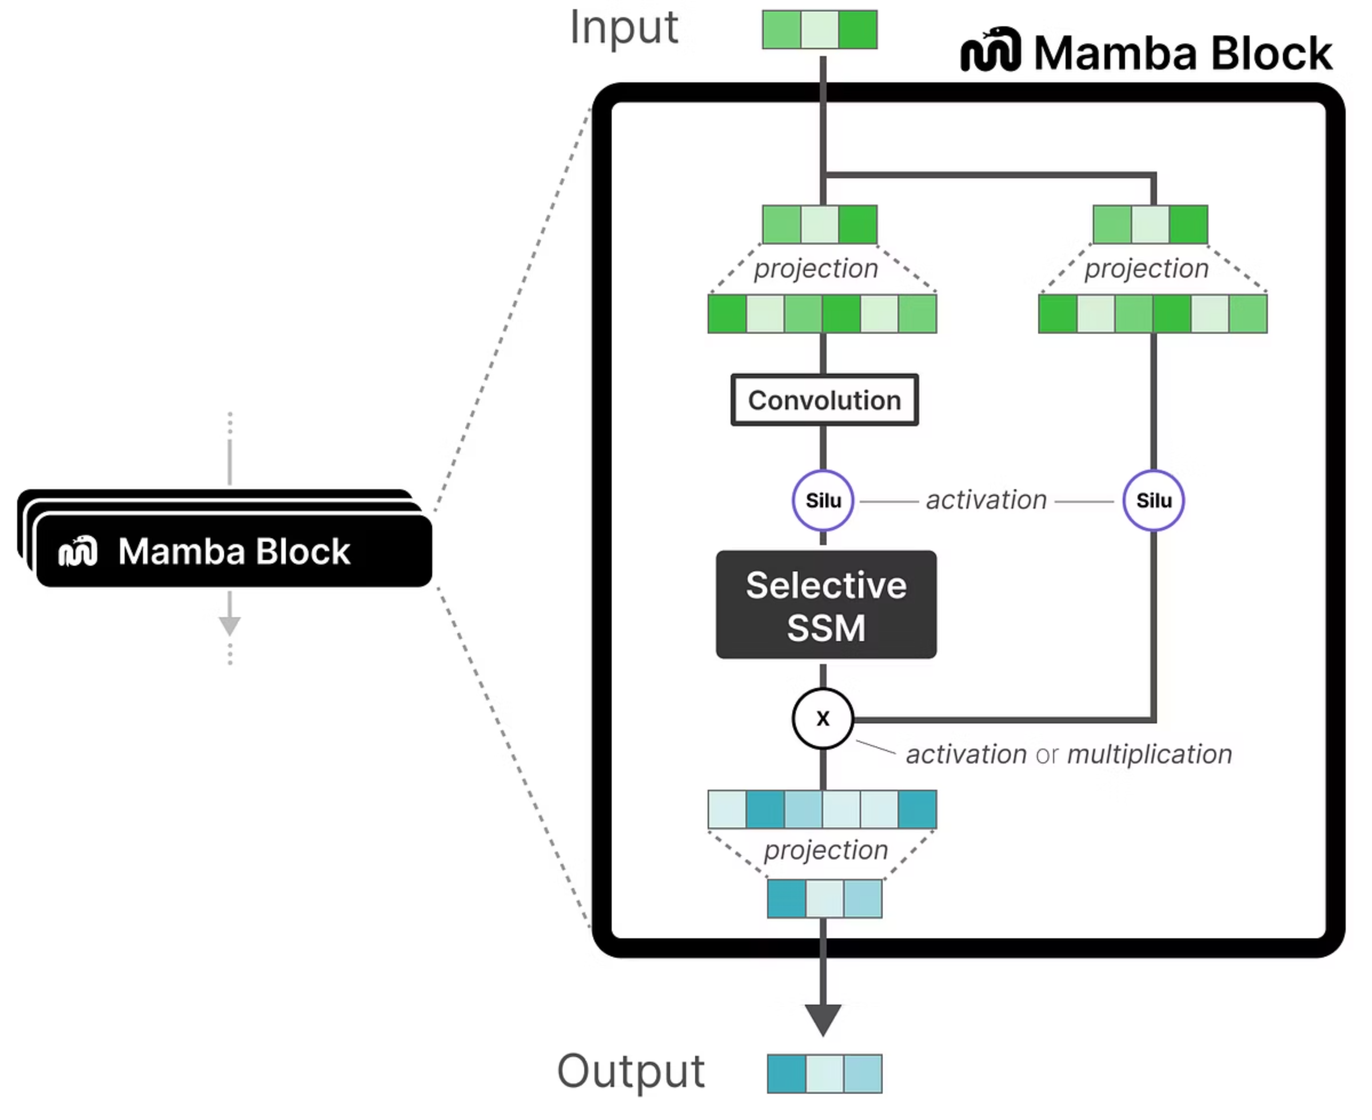
Strategic Shift: Adopting Standard Mamba v1
Architectural Simplification
Temporal Modelling Focus
Single unified processing path replaces multi‑channel branching, reducing structural complexity whilst maintaining expressiveness.
Mamba v1's selective state‑space design excels at short‑window temporal sequences typical of wireless localisation tasks.
Deployment Advantages
Streamlined architecture enables easier optimisation, quantisation, and hardware mapping for embedded deployment.
Notes:
we can see the key feature of mamba block is the selective SSM part witch ensures the strong ability of historical memory capabilities

Slide 18

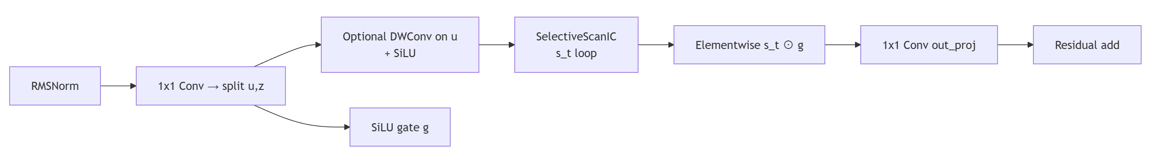
Strategic Shift: Adopting Standard Mamba v1
Hardware‑Friendly Refactor
Notes:
So I attempted to simplify this part , retaining it’s shorter window memory capability while making it easier to implement on the FPGA

Slide 19
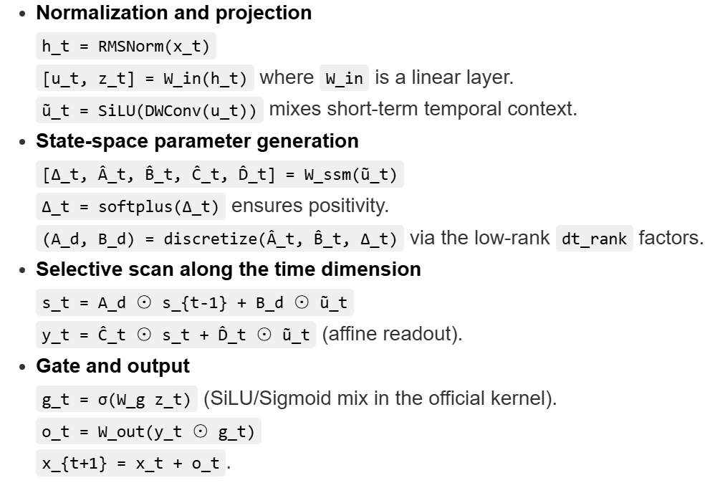
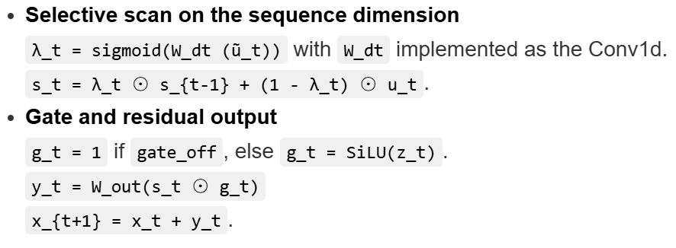
Strategic Shift: Adopting Standard Mamba v1
Hardware‑Friendly Refactor
Mamba V1
Slim Mamba
Notes:
So I attempted to simplify this part , retaining it’s shorter window memory capability while making it easier to implement on the FPGA

Slide 20
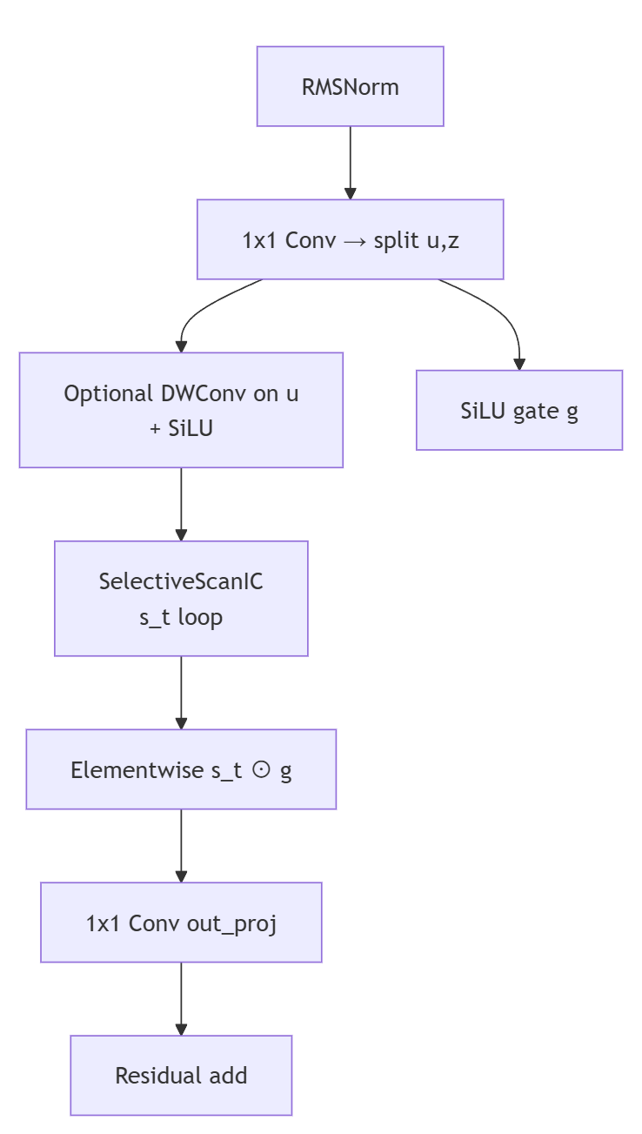


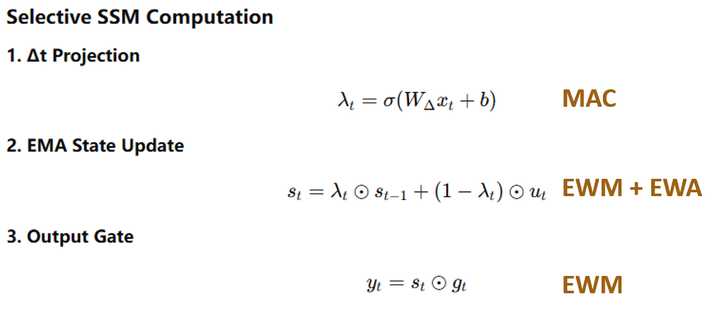


Final Architecture: MambaSlim Pipeline
Hardware‑Friendly Refactor
Input Projection
Linear embedding of raw CSI features into latent space
Patch Embedding
Temporal segmentation (patch_len=8, stride=4)
Slim Mamba Blocks
3 layers with residual connections and RMSNorm
Prediction Head
Regression to (x, y) coordinates

Slide 21
Strategic Shift: Adopting Standard Mamba v1
Results
Architectural Simplification
Temporal Modelling Focus
Mamba v1's selective state‑space design excels at short‑window temporal sequences typical of wireless localisation tasks.
Hyperparameters
Window length: K=16 samples
Projection dimension: 64
Model dimension: d_model=64
Network depth: 3 layers
Patch configuration: length=8, stride=4
Window lenth K is relatively short (K=16, 0.16s), falling within the category of short-time sequence modeling scenarios. Result shows that high accuracy can be achieved within this window, indicating that complex high-order state evolution is unnecessary. Based on this observation, we no longer pursue modeling the full complex state space of Mamba. Instead, we perform hardware-friendly modifications to Mamba v1.

Slide 22



Experimental Configuration & Training Setup
Model Hyperparameters
K = 16 (SSM state dimension)
proj_dim = 64
d_model = 64
n_layer = 3
patch_len = 8, stride = 4
Training Configuration
Batch size: [64]
Learning rate schedule: [1.5e-5]
Training epochs: [20]
Optimiser: AdamW
Evaluation Metrics
EPE (End‑Point Error)
MAE (Mean Absolute Error)
Spatial error distribution
Per‑grid accuracy analysis

Slide 23
SSM Accelerator Design for MIMO Indoor Localiztion
Shengjie Chen

Slide 24
Contents
1. Background
Why use Mamba
Why SSM acceleration is vital
1
2. Hardware Architecture
Trade-off 1: MAC Architecture Selection
Trade-off 2: Memory Selection - Single port vs. Dual Port
Trade-off 2: Resource vs. Latency - Reconfigurable vs. Fine-grained pipeline
3. Results
Utiization, Frequency and Power

Slide 25
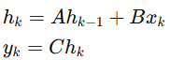
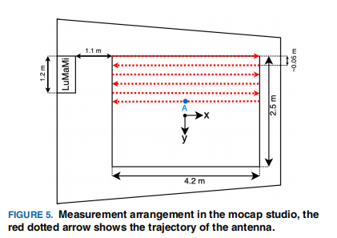
Background - Why use Mamba
Mamba is a State Space Model
MIMO localization using Radio data
Using hidden states to store historical information and process sequences with recursive updates.
Position Estimation on Continuous Trajectories
Time-related + Space-related
Good temporal continuity: Naturally encode the “previous-time-step position/channel evolution” into the state hk
Low complexity: Transformer's self-attention inherently requires considering the entire sequence history over length L, whereas Mamba's scan only needs the state from the previous step.
G. Tian, I. Yaman, M. Sandra, X. Cai, L. Liu and F. Tufvesson, "Deep-Learning-Based High-Precision Localization With Massive MIMO," in IEEE Transactions on Machine Learning in Communications and Networking, vol. 2, pp. 19-33, 2024, doi: 10.1109/TMLCN.2023.3334712.

Slide 26
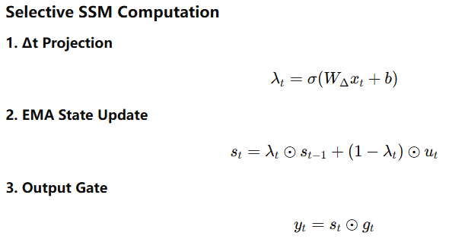
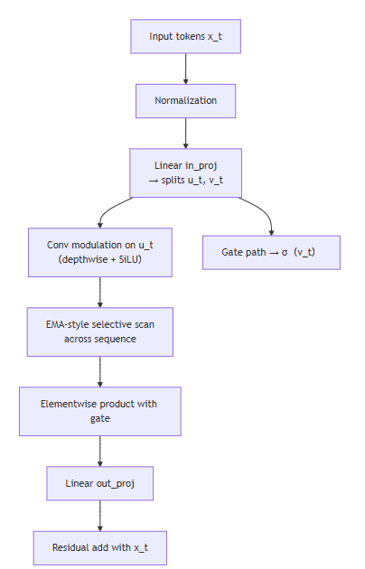
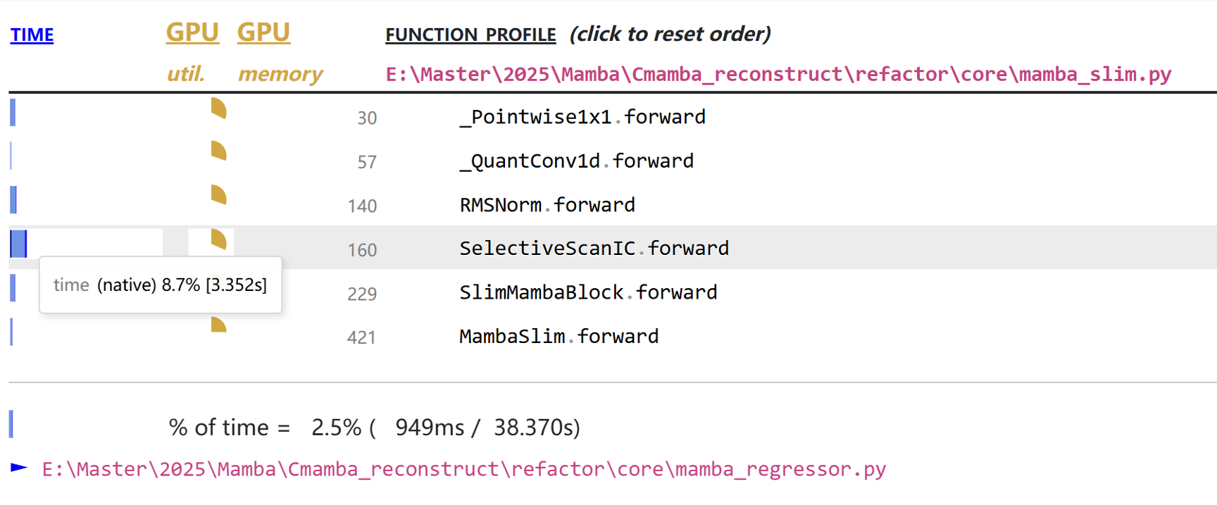
Background - Why SSM Acceleration is Vital
SMM dataflow => Calculation
MAC
EWM + EWA
EWM
SSM
SSM is the most time-consuming part in Mamba

Slide 27
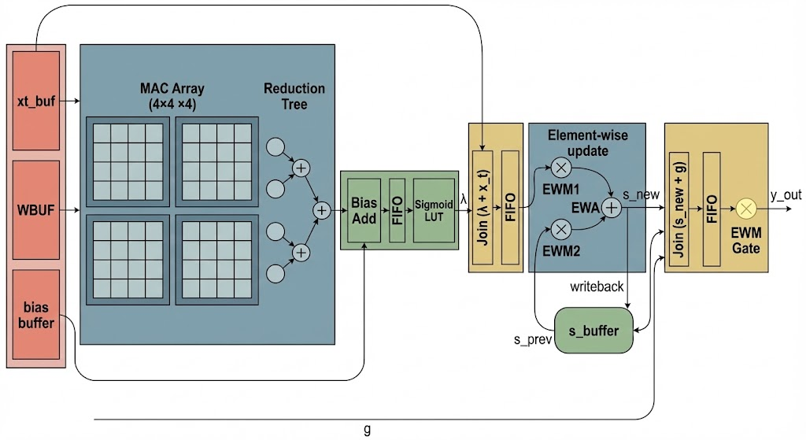
Mamba SSM Design - Architecture
MVM
Update State
Output Gate
Nonlinear layer

Slide 28
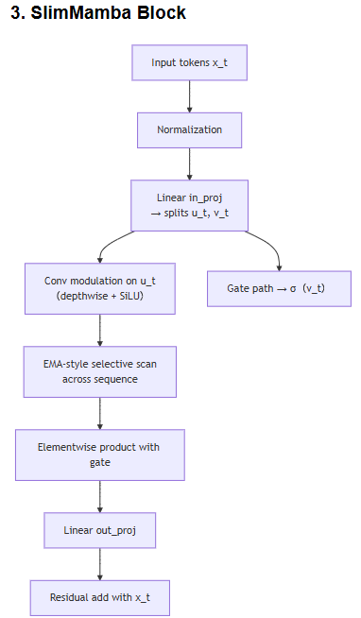
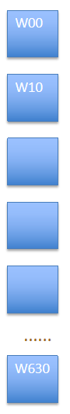
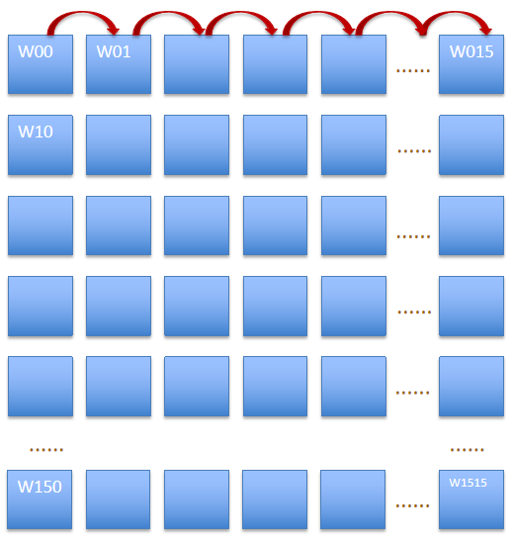
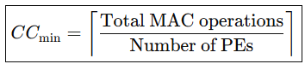
Mamba SSM Design - MAC array design
Goal: (256,256) * (256,1) MVM - Total MACs=256×256=65536
Method 1: 16*16 Systolic Array fit for GEMM, bad for GEMV
Method 2: 64*1 GEMV unit
Each tile:
MAC:
1 cycles calculating
(256,256)*(256,1)
4*256=1024 tiles
In total: 1024*1=1024 ccs
Bandwidth: 64 weights/cycle
(works well for mvm, limited Reusability for GEMM)
GEMM
GEMM
Each tile:
16 cycles calculating, (256,256)*(256,1)
Min. latency In theory: 256*256/256 = 256 ccs
Bandwidth: 256 w/cycle
(stuck when run implementation)

Slide 29
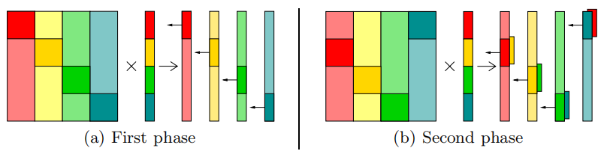
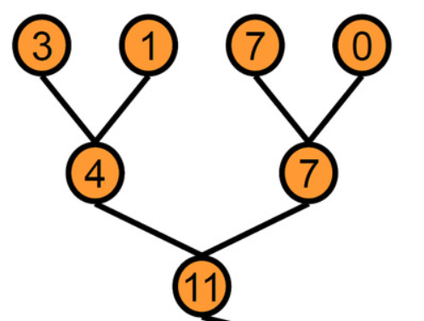
Mamba SSM Design - MAC array design
Method 3: small parallel array (4*4) + pipeline
compromise solution
Each tile:
MAC: 16cycles each tile
(3ccs filling pipeline + 3ccs reduction)
(256/4=64 tiles)
In total: 64*16+3+3=1030cc
Bandwidth: 64 weights / cycle
B: 4*4 block
 | ARRAY1 | ARRAY2 | ARRAY3 | ARRAY4
cycle1 | B1
cycle2 | B5 | B2+B1
cycle3 | B9 | B6+B5 | B3+B2+B1
cycle4 | B13 | B10+B9 | B7+B6+B5 | B4+B3+B2+B1
cycle5 | B17 | B14+B13 | B11+B10+B9 | B8+B7+B6+B5
cycle6 | ... | ... | B15+B14+B13 | B12+B11+B10+B9
cycle7 | ... | ... | ... | B16+B15+B14+B13
... | ... | ... | ... | ...
... | ... | ... | ... | ...
... | ... | ... | ... | ...
cycle19 | ... | ... | ... | B64+B63+B62+B61
reduction unit
cost 3 cycles
cycle19
cycle20
cycle21
cycle22
at cycle 22 first tile compete, generating first 4 output!
(output vec demension (256,1) )
at cycle 19 first 4 rows of (256,256) is completed!
K. B. Theobald et al., "Landing CG on EARTH: A Case Study of Fine-Grained Multithreading on an Evolutionary Path," SC '00: Proceedings of the 2000 ACM/IEEE Conference on Supercomputing, Dallas, TX, USA, 2000, pp. 4-4, doi: 10.1109/SC.2000.10011.

Slide 30
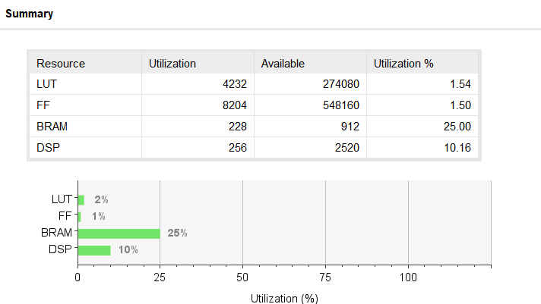
Trade Off 1: MAC Architecture Selection
 | 16*16, Systolic | 64*1, GEMV | 4*4*4, pipeline
wires | +++ | + | ++
DSPs | 256 | 64 | 64
BW (Weights/cycle) | 256 | 64 | 64
Clock Cycles (256,256) MVM | 256 | 1024 | 1024
Reusability | +++ | + | +++
Mem. access | simple | simple | interleaving
choose the 4×4×4 pipelined array because :
achieves the same 1024-cycle latency and 64 weights/cycle bandwidth as the 64×1 GEMV design, while providing much higher reusability across GEMV/GEMM/EW kernels
better timing/routing scalability than a monolithic 16×16 systolic array
However the cost is bank-interleaved memory access.

Slide 31
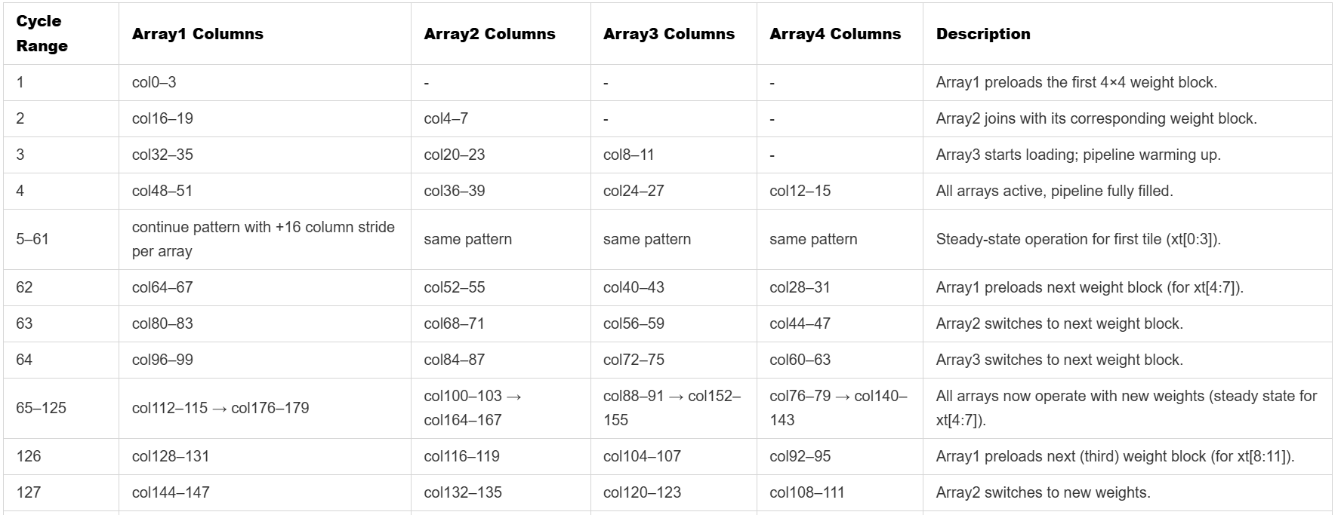
Memory Access Pattern for MVM

Slide 32
Memory Access Pattern for MVM
△=12
△=12
△=12
x_proj: RAW=Wx_pj * x_t
Weight: Wx_pj (40,256)

Slide 33
Memory Access Pattern for MVM
△=16
△=12
△=12
△=16
△=16
△=12
Requirements:
Each array fetches one 4×4 column block per cycle.
Column spacing between adjacent arrays within the same cycle = 12 columns.

Slide 34
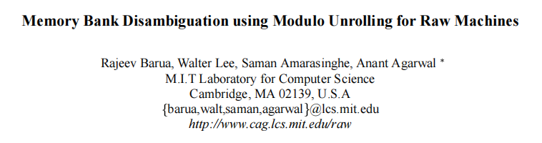
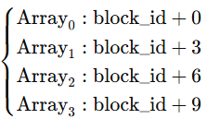
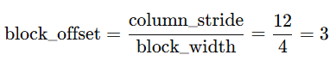
Interleaving Memory Bank Design
Requirements:
Each array fetches one 4×4 column block per cycle.
Column stride between adjacent arrays within the same cycle = 12 columns.
Guarantees conflict-free parallel read for all 4 arrays.
Questions:
How many banks? (NBank=?)
How weights data distribute? (round-robin mapping)
How to access? (bank_id=?@each cycle)
Bank Mapping Function:
bank_id=(block_id+3n) mod NBank
for example, at cycle = 4
Array0=col48-51, Array1=col36-39, Array2=col24–27, Array3=col12–15
block_id=12
Array0=block_id+0
Array1=block_id+3
Array2=block_id+6
Array3=block_id+9
1 block covers 4 x 4 weight data, block_id=⌊col/4⌋, n=array_id
Array_n​ → block_id+3n
4 arrays simultaneously read different column blocks, spaced 3 blocks apart from each other.
Regardless of the size of block_id, the bank number falls within the range 0~Nbank−1. => modulo Unrolling

Slide 35

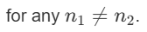
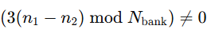
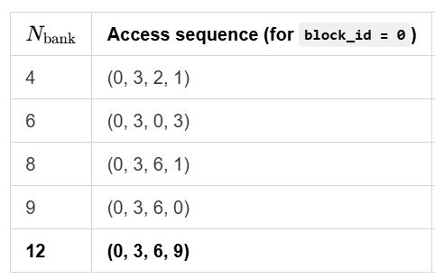
Interleaving Memory Bank Design
Questions:
How many banks? (NBank=?)
How weights data distribute?
How to access? (bank_id=?@each cycle)
Conflict-free condition:
No Space-Conflict: We want the bank_id values accessed by the 4 arrays to be all different.
No Temporal-Conflict: Bank reuse distance < Bank access latency
Bank Mapping Function:
bank_id=(block_id+3n) mod NBank
Since block_id is fixed within the same cycle, the difference condition becomes:
Nbank = n_array × block_offset=4x3=12
12 is the smallest and only possible number of Banks that can achieve a cycle without conflicts.
RAM IP: Read latency=2
AXI-Stream：2
one full rotation =12 beats;
Each beat accesses 4 different banks across 4 arrays;
Pattern repeats after 4 beats → Easy scheduling.
Bank reuse distance =1, temporal conflict
Bank reuse distance =2, temporal conflict
Perfectly distinct and periodic

Slide 36
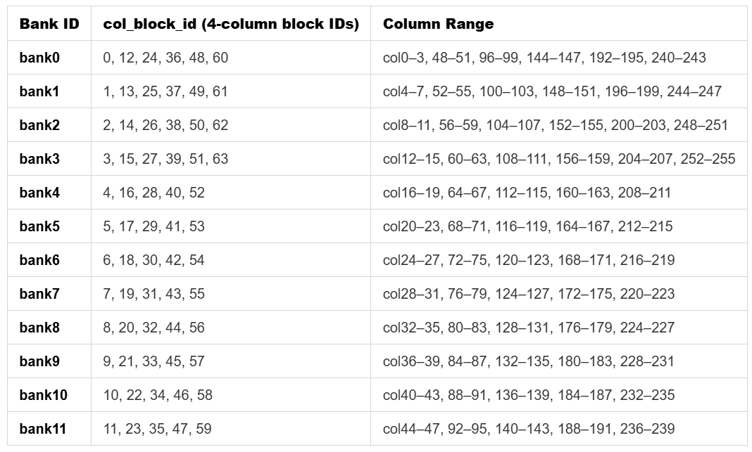
Interleaving Memory Bank Design
Questions:
How many banks? (NBank=?)
How weights data distribute?
How to access? (bank_id=?@each cycle)
Bank Mapping Function:
bank_id=(block_id+3n) mod NBank
Nbank = n_array × block_offset=4x3=12
12 is the smallest and only possible number of Banks that can achieve a cycle without conflicts.
one full rotation =12 beats;
Each beat accesses 4 different banks across 4 arrays;
Pattern repeats after 4 beats → Easy scheduling.
Each bank receives at least 5 blocks. The remaining 4 blocks can only be allocated to the first 4 banks.

Slide 37
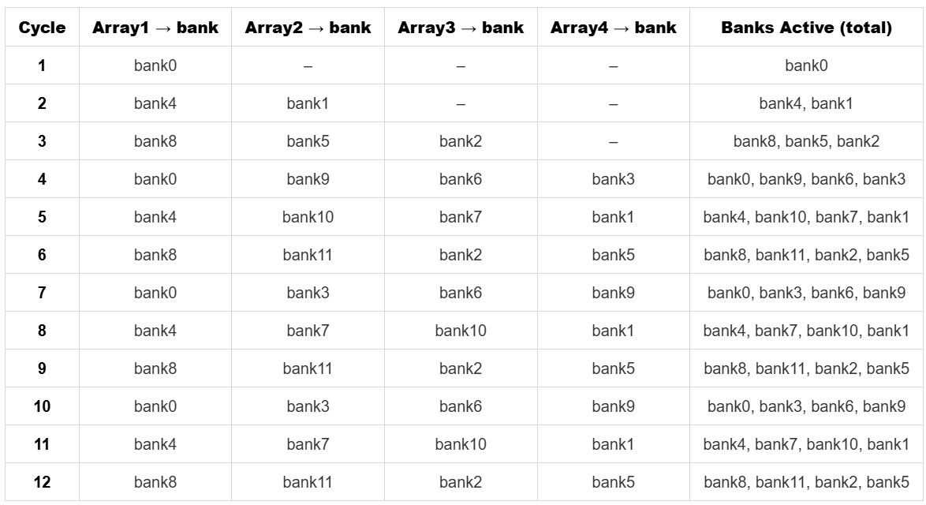
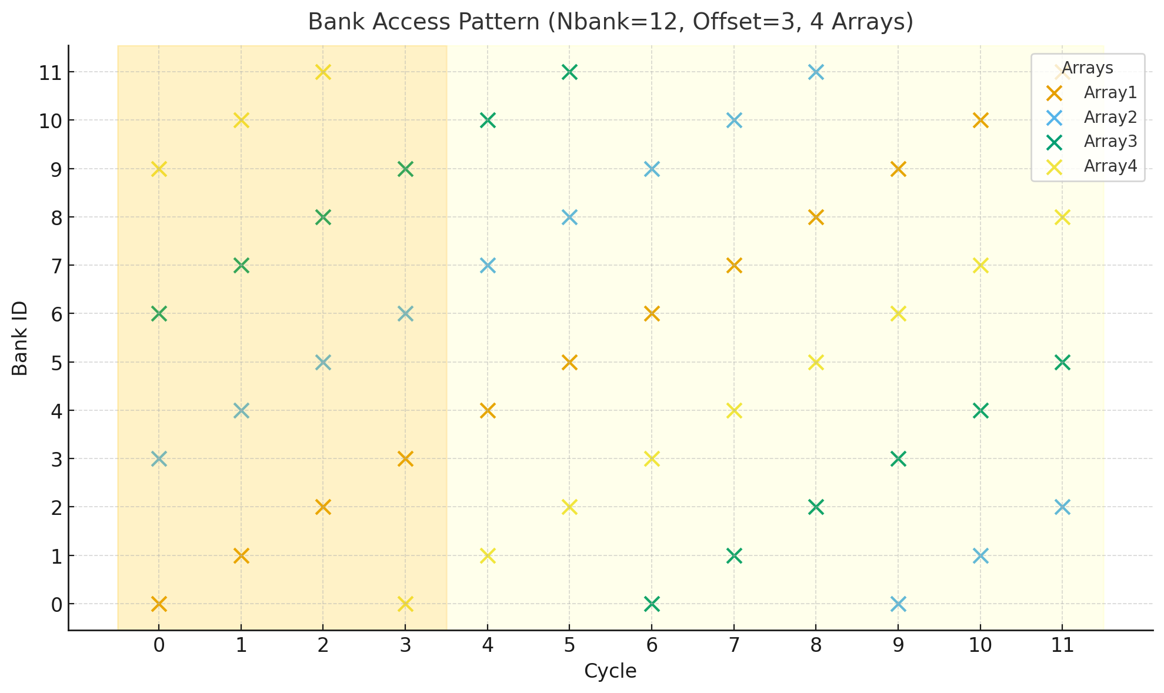
Interleaving Memory Bank Design

Slide 38
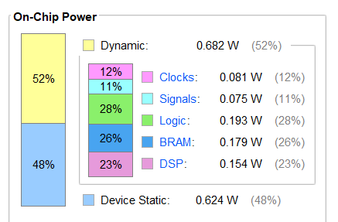
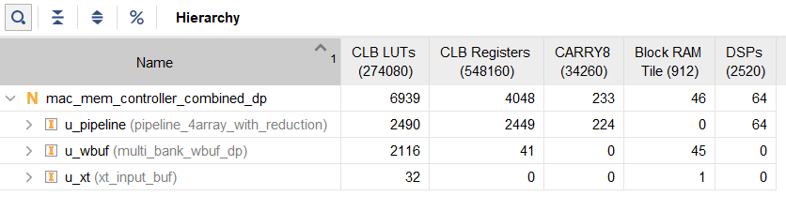
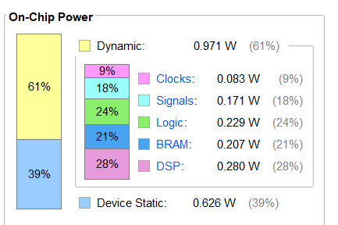
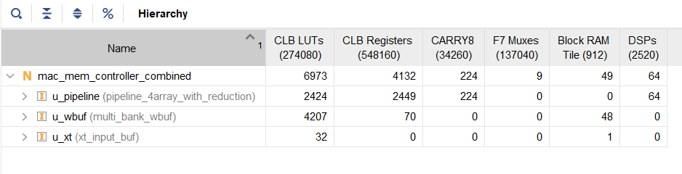
Trade Off 2 - Single port vs. Dual Port
Dual-port:
Single-port:
Dual port has smaller power and area

Slide 39
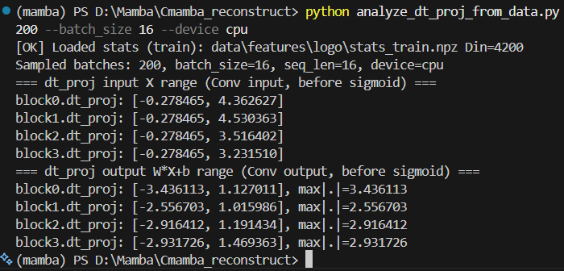



Nonlinear layer - Sigmoid
clamp x to [-4, +4)
LUT: 2048 sigmoid outputs

Slide 40


Nonlinear layer - Sigmoid

Slide 41

SSM Control: AXI-Stream + FIFO
Master
TVALID
Slave
TDATA
TREADY
// AXI-Stream interface signals
input logic s_axis_TVALID,
output logic s_axis_TREADY,
input logic [DATA_W-1:0] s_axis_TDATA,
output logic m_axis_TVALID,
input logic m_axis_TREADY,
output logic [DATA_W-1:0] m_axis_TDATA
MAC
(dt_proj)
TVALID
FIFO
TVALID
Sigmoid
TDATA(Δ_raw)
TDATA(Δ_raw)
TREADY
TREADY
Each FIFO acts as an AXI-Stream bridge ensuring smooth data flow across modules.
Provides intermediate buffering, rate matching, and timing decoupling, ensuring stable pipeline flow.

Slide 42


Trade Off 3: Reconfigurable vs. Fine-grained pipeline
mode Calculation
00 MAC (A*B+acc_in)
01 MUL (A*B)
10 ADD (A+B)
Latency Comparison (N tiles)
MAC produces one tile every 22 cycles (given).
From code:
sigmoid4_vec throughput ≈ 1 tile / 2 cycles
ew_update_vec4 throughput ≈ 1 tile / 7 cycles
→ downstream bottleneck ≈ 7 cycles per tile
Case A: wait for all MAC tiles, then run Sigmoid/EW
T_A = 29N
Case B: stream each tile to Sigmoid/EW as soon as MAC finishes
T_B = 22N + 7
Latency saving
For N = 64
T_A = 1856 cycles
T_B = 1415 cycles
Saving = 441 cycles
Saving ratio ≈ 23.8%
R. Wei et al., "LightMamba: Efficient Mamba Acceleration on FPGA with Quantization and Hardware Co-design," 2025 Design, Automation & Test in Europe Conference (DATE), Lyon, France, 2025, pp. 1-7, doi: 10.23919/DATE64628.2025.10993079.

Slide 43

Simulation

Slide 44



Synthesis - 400MHz

